Slide 1
Evolutionary Perspective
Notes:
Why study evolution
Know thyself
Know thyself and other humans: diseases
Know much more about biology
Provide examples of an evolutionary perspective: For example, why do birds migrate from the tropics to N. America. Proximate causes = seasonal changes, hormone responses. Ultimate causes: Those that migrate enjoy the selective advantage of the great density of insects during the N. American summer.

Slide 2
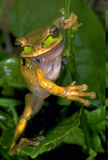
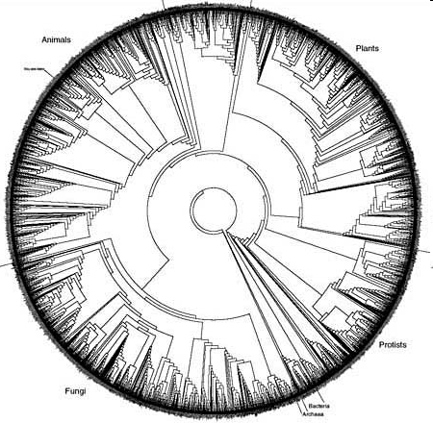
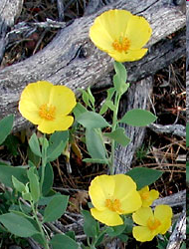
Tree of Life

Slide 3
Evolution 370
How did this diversity arise?
What are the selective agents responsible for evolution of specific traits (adaptive value)?
What are the genetic and environmental processes that underlay evolution?
How can I better understand the natural world around me, including humans (morphology, behavior, diseases, etc.)

Slide 4
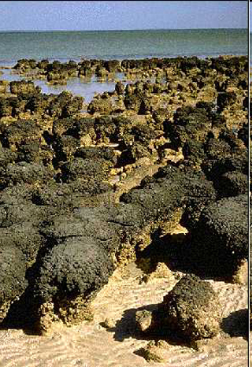
What is the origin of biological diversity?
Mutations
Sex = Recombination = Meiosis
This view of the shallows of Shark's Bay, Australia, shows a colony of living stromatolites. ©Isao Inouye (University of Tsukuba), Mark Schneegurt
(Wichita State University), and Cyanosite (blue-green algae, cyanobacteria)

Slide 5
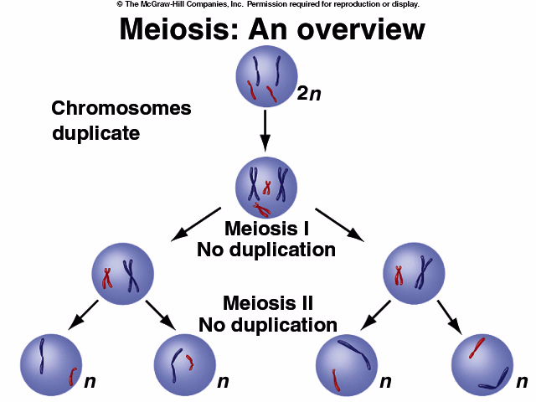
Notes:
Note difference with mitosis, 2n to 4n to 2n to 1n, is there a need to go from 2n to 4n??, ancestral condition mitosis, so doubling?

Slide 6
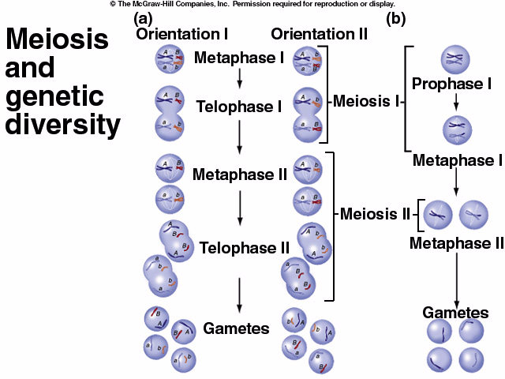
Mixing
Chromosomes
From
Different
Parents
Notes:
Go over this carefully. Note Recombination among chromosomes

Slide 7
Independent Assortment Again
Chromosome Behavior &
Independent Assortment
Notes:
Note difference between assortment and segregation

Slide 8
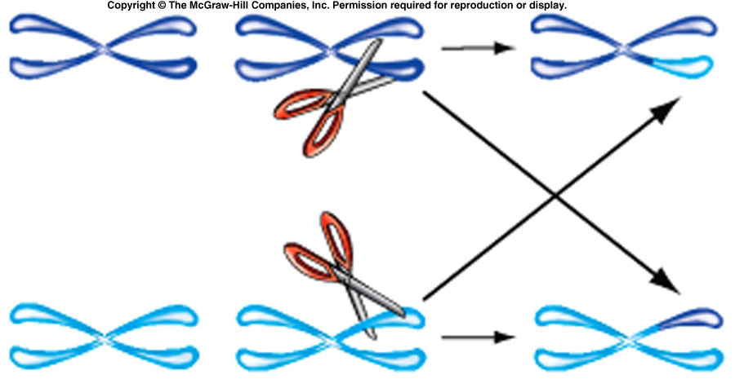
More Genetic Diversity: Mixing Genes Within
a Chromosome

Slide 9
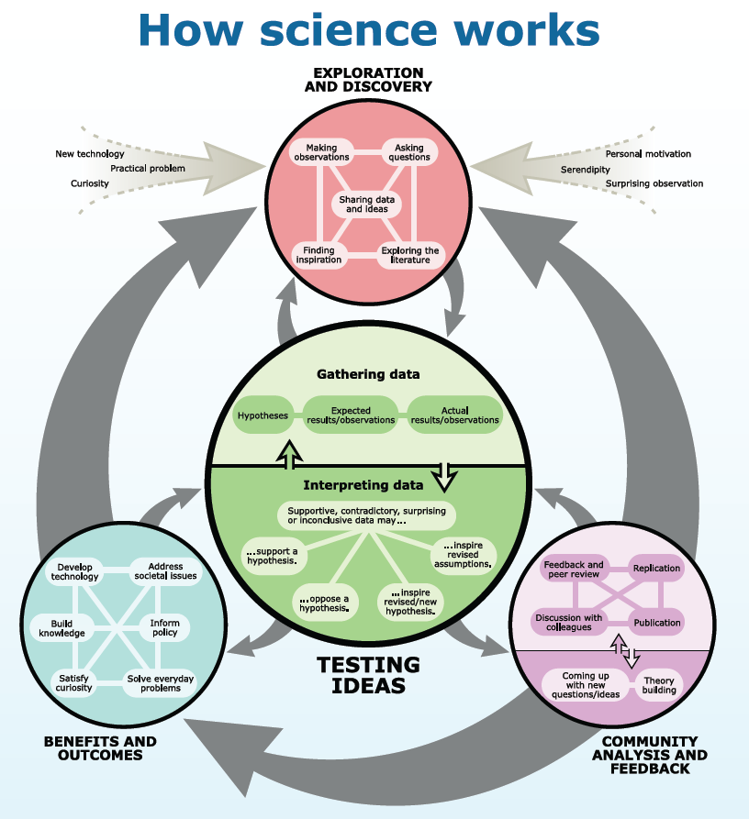
The Process of Science

Slide 10
Operating Budget University of Maryland: Research 1 University
Other
State
Federal
from
Grants
Tuition

